Slide 1

EE 2240 Sophomore Design laboratory
Section 002, Spring 2023 Team members: Jose, Binh, Jonathan, Devin
Project topic: Pv-battery Integrated Energy source

Slide 2
Topics and Goals

Slide 3
Introduction
Topics:
How PV-battery integration works
Objectives and Goals
Challenges and Solutions
Design process
Roles and Scheduling
Q&A
Goals:
Our goal is to design a circuit in which we can store and supply solar energy to a mobile device.
Notes:
Info Dump: (will overwrite this slide)
The main objective of the project is to design a circuit in which the various components we introduce to the circuit will be able to interact with each other in the way we want them to. This circuit will be designed in a certain way to complete a certain task. Our goal is to create a PV battery integrated energy source, this device will allow for the capture of energy through solar panels; this energy will then be used to charge a load (phone), with excess energy from the solar panels being stored inside a battery. Topics will consist of explaining the components that we will use in our circuit(and how they work), explaining the general design of the circuit, talking about challenges we will face throughout this process, and the roles and responsibilities each member has.

Slide 4
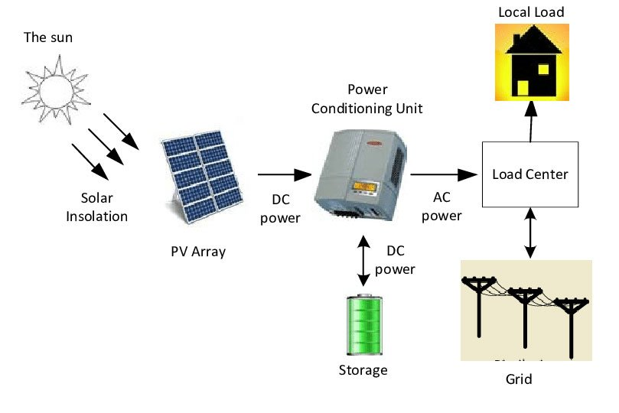
How PV-Battery Integration works
Sunlight hits the solar panels, and the energy is converted to DC electricity. The electricity enters the battery and is stored as DC electricity to be used as a backup power source for the home. Most of the power generated by the PV array is used by the local load (house).

Slide 5
Objective
Objective: Control the power the load receives based on sunlight conditions so that it receives a constant supply
PV Array
Load
Buck-Boost Converter
Battery
PWM Emitter
Gate Driver

Slide 6
Challenges and Solutions
Notes:
Info dump:
Challenges:
If during the testing phase, the load receives too much power, there is a chance it could damage it. We will need a protection mechanism to ensure the device isn't damaged.
The biggest challenge of this circuit will be the bidirectional circuit section of the process. This sub circuit will need to have a mechanism in which it allows the battery to be charged and discharged when not enough solar energy is being supplied to the load.
If there is a sudden drop in solar energy, there will be a moment when the phone stops charging and waits till the battery turns on.
Solutions:
Multiple solutions to the problems presented is the use of a voltage regulator(which is connected to the load). This component will ensure the device is not damaged.
The flow of power from the battery can be regulated through the use of the msp432. This microcontroller will interact with the gate drivers to control how much power needs to be fed by the battery.
Capacitors will allow us to counteract the drop of power the load may receive due to changes in solar energy. This way the phone can remain charging even with sudden drops in solar energy.

Slide 7

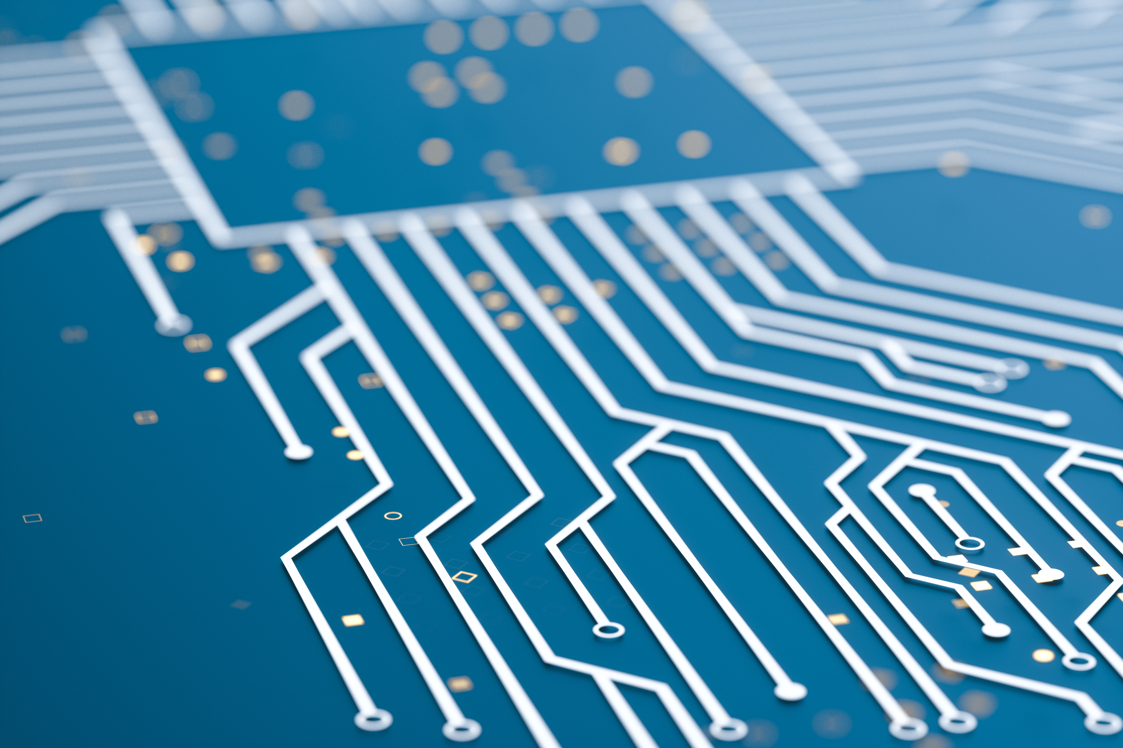
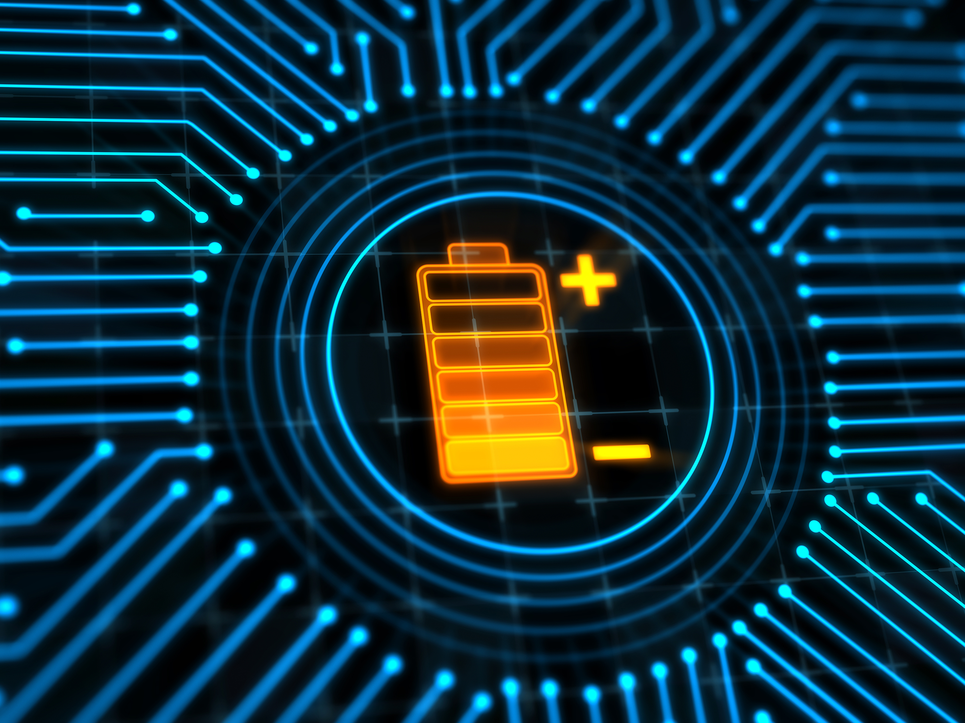
Challenges
1. If, during the testing phase, the load receives too much power, there is a chance we could damage it. We will need a protection mechanism to ensure the device doesn’t get damaged.
2. The biggest challenge of this process will be the bidirectional circuit. This sub circuit will need to have a mechanism in which it allows the battery to be charged and discharged when not enough solar energy is being supplied to the load.
3. If there is a sudden drop in solar energy, we risk not supplying energy from the battery fast enough. We will need to ensure there is a smooth transition of power from the solar panel and battery.

Slide 8
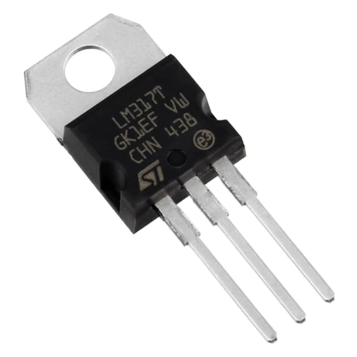
Solution 1.
A possible solution to Problem 1 can be a voltage regulator. If we connect this device to the load, it can prevent it from receiving too much power.

Slide 9
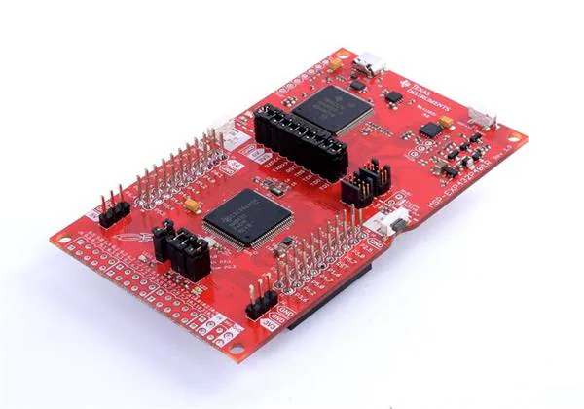
Solution 2.
By using a micro-controller, specifically the MSP-432, we can control the gate drivers to regulate the flow of power from the battery. This will ensure the load receives the necessary power and allow the battery to be charged when it's not in use.

Slide 10
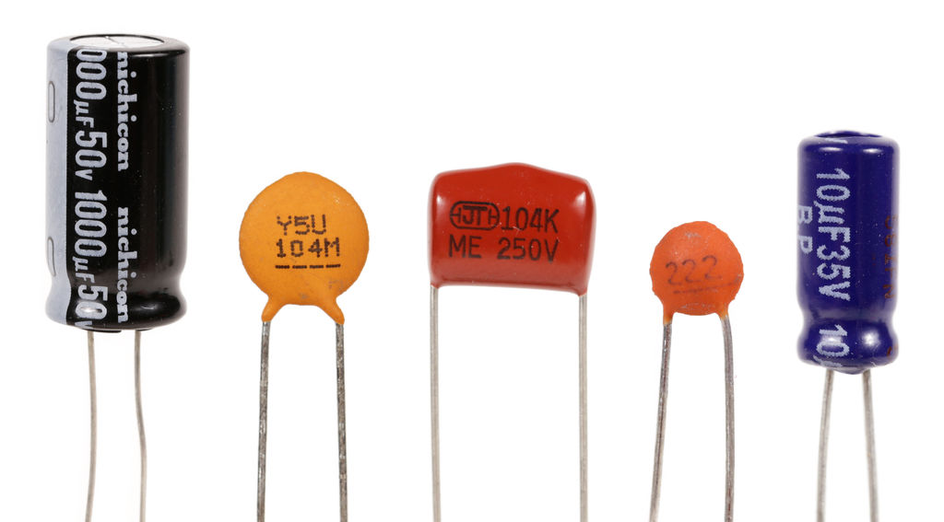
Solution 3.
With the use of capacitors, we can ensure there are no abnormal drops of voltage across the load. With the introduction of this component, there will be no uninterrupted power provided to the phone.

Slide 11
Design Process
Notes:
This section will include:
the types of circuits we will be using
the list of components people might not be familiar with
These components will be explained as well as the role they have in the circuit
Toward the end of this section, a slide will include a diagram of how the different parts of the circuit will be connected.

Slide 12
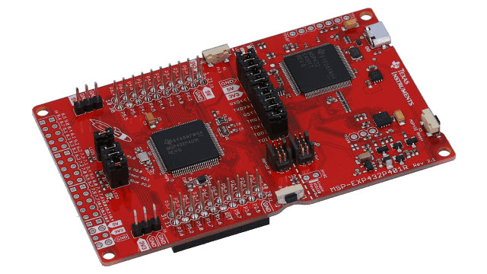
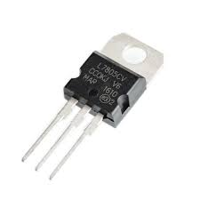
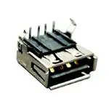
Special Parts
L7805CV Voltage Regulator
MSP-432 Microcontroller
USB 2.0 Port
Notes:
Explain other parts used in the project that people might not be familiar with.
L7805CV Voltage Regulator – Designed for 5V at 1.5A. Sets the voltage to 5V specifically and prevents the mobile device from drawing too much power.
MSP-432 Microcontroller – Used to control the gate driver.
USB 2.0 Port – Used only to supply power to the mobile device, no data will be connected.

Slide 13
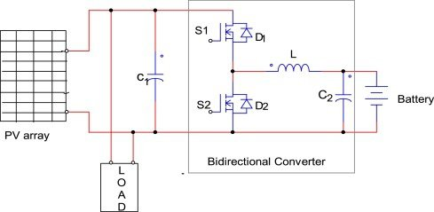
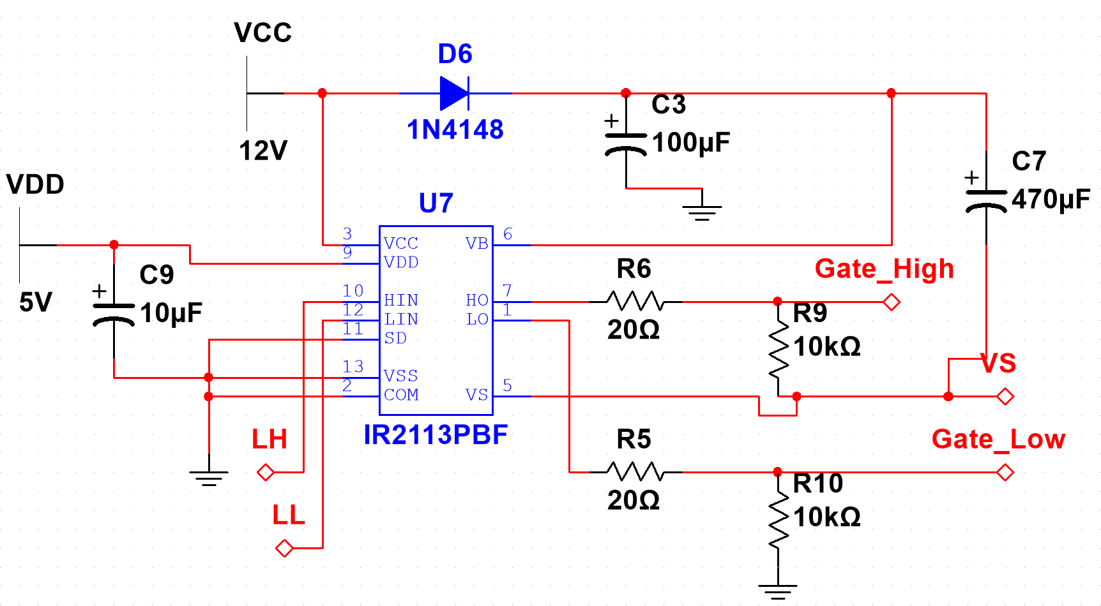
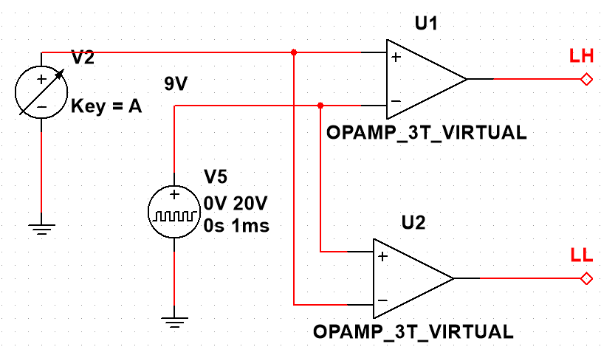
Circuit Types
Gate Driver
PWM Emitter
DC-DC Bidirectional Converter

Slide 14
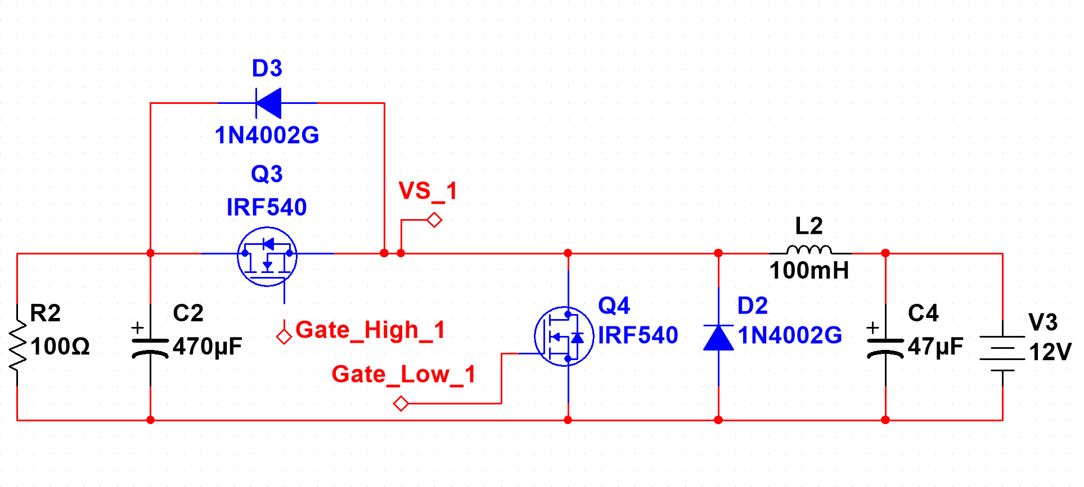
Buck-Boost Converter
Buck mode
Boost mode
Notes:
Explain in more detail what the buck-boost converter does and how it relates to project design.

Slide 15
Roles and Scheduling

Slide 16
Roles
We will be assigning roles and responsibilities, with each being equally as important as one another.
Devin – Designer
In charge of creating a general layout for an efficient circuit; this includes designing a layout for the breadboard prototype and the PCB.
Jonathan – Prototyping and Implementation
Binh– Prototyping and Implementation
In charge of implementing the circuit onto a breadboard as well as testing. If problems arise, they will need to communicate the issue to the designer and collaborate to fix the problem.
Jose – Project Manager
In charge of ensuring deadlines are met. The manager is also responsible for oversight into who isn't contributing. For the most part, the project manager should be flexible and is expected to able to either help with designing or prototyping and implementation.

Slide 17
Scheduling
Tasks:
Task 1: Simulation and Programming
Subtask 1.1: Simulate Buck-boost converter with resistor load
Subtask 1.2: Research MSP-432 functions
Subtask 1.3: Program MSP-432
Milestone 1.3.1: Complete simulation and programming
Task 2: Hardware prototype
Subtask 2.1: Get a list of parts and place order
Milestone 2.1.1: Complete order placement
Subtask 2.2: Test Gate Driver with function generator
Subtask 2.3: Test Buck-Boost converter with function generator
Subtask 2.4: Test Buck-Boost converter with microcontroller
Subtask 2.5: Test PV-Battery IES prototype
Milestone 2.5.1: complete PV-Battery IES prototype

Slide 18
Scheduling
Tasks:
Task 3: PCB Design, Soldering, and Final Test
Subtask 3.1: Design PCB
Milestone 3.1.1: Submit PCB Design for printing
Subtask 3.2: Soldering
Subtask 3.3: Final Test and Adjustment
Milestone 3.2.1: Complete Final Design
Subtask 3.4: Prepare Final Deliveries
Milestone 3.3.1: Submit all Deliveries

Slide 19


Slide 20


Slide 21

EE 2240 Sophomore Design Project
Section 002, Fall 2023
PV Battery Integrated Energy Source
Project Progress Presentation
Team Members: Jose Guzman, Devin Hernandez, Jonathan Dolormente, Binh Duong

Slide 22
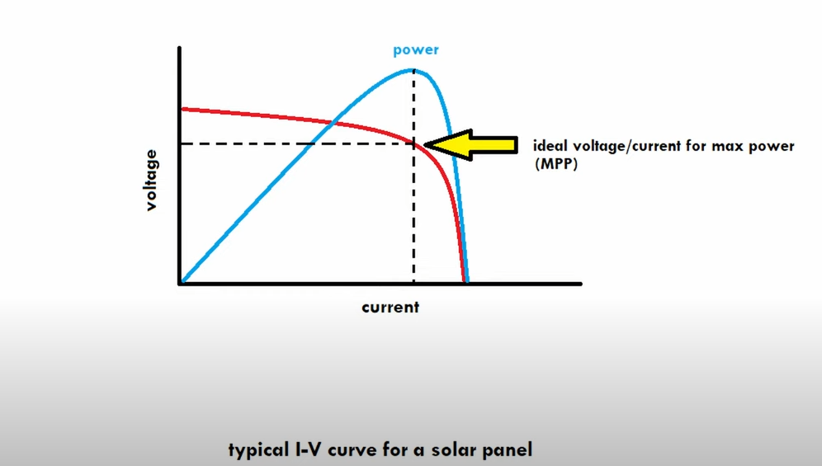
Maximum power point tracking (MPPT)
Solar arrays output the highest power output (in watts) at a specific Voltage x Current combination. That point is called the MPP.
The MPP can shift depending on sunlight and temperature.
Notes:
START OF PRESENTATION STEP 1: DETAILED TECHNICAL PLANS

Slide 23
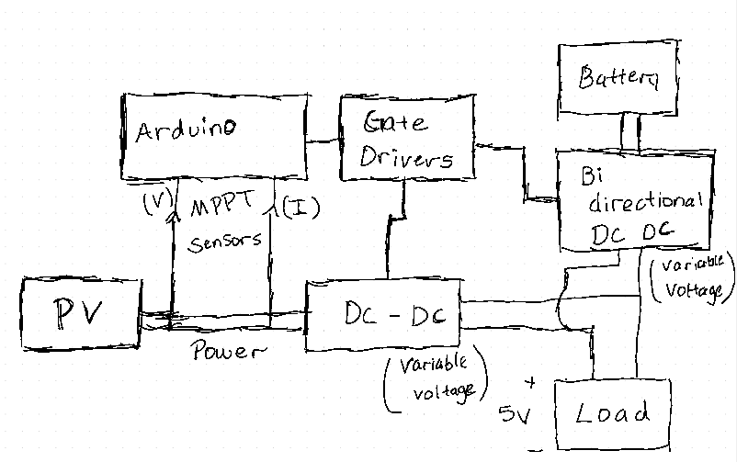
Circuit Topology

Slide 24

Project Milestones
We…
Received the components from our parts list.
Began Implementation of the simulation onto our physical breadboard.
Began to program our Arduino Microcontroller to output a PWM signal.
Began to test our gate driver circuit.
Began to investigate DC to DC converters (used for MPPT) for our solar array.
Notes:
START OF PRESENTATION STEP 2: CURRENT PROGRESS

Slide 25
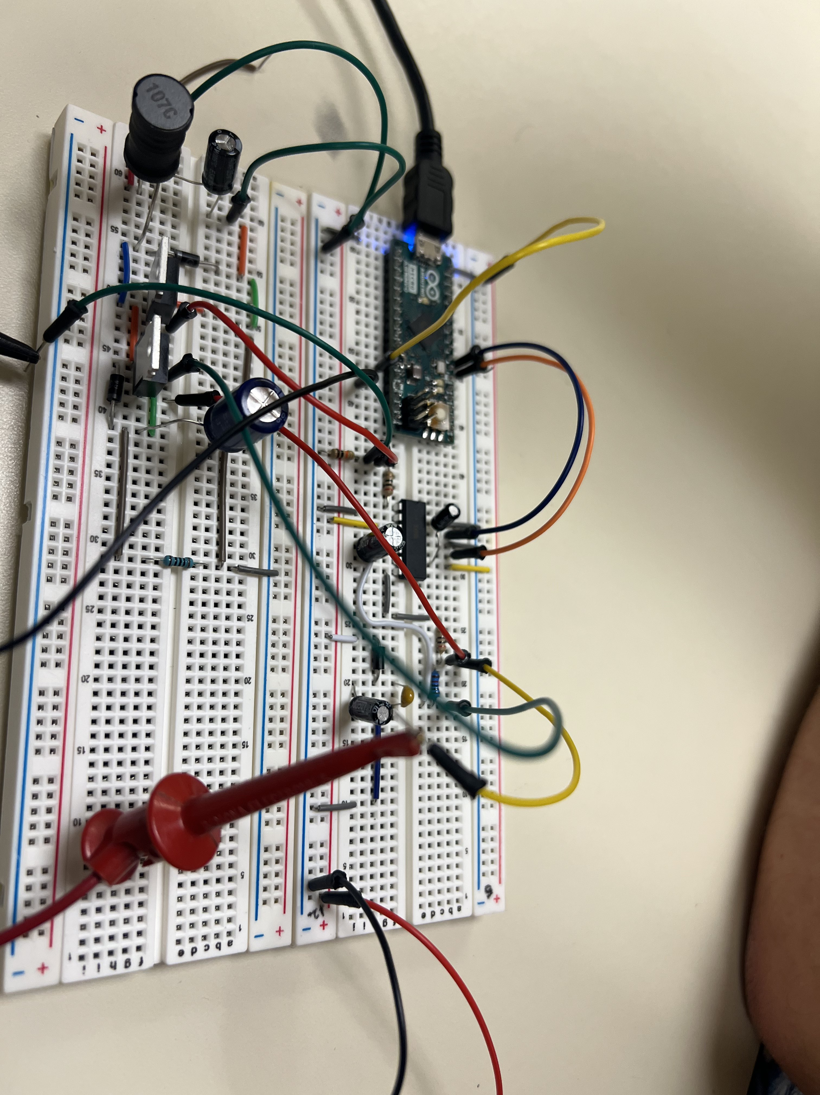
Prototype 1
This prototype contains both of our dc-dc converters, as well as the gate driver for the bidirectional dc-dc. We're using an Arduino, situated on the breadboard, to generate PWM signals. These signals are directed to the gate driver. The gate driver then modulates the DC-DC converter, governing both the buck and boost operations to achieve our desired voltage regulation.
Notes:
This slide will be dedicated to talking about programming the Arduino, what we plan to use it for. For example, we might include that we plan on programming the Arduino to control our gate driver, as well as reading power output from our solar panel to ensure MPPT (this will topic will continue on the next slide.)
We should include pictures or videos of our breadboard layout and maybe even how envision our future layout to look.

Slide 26
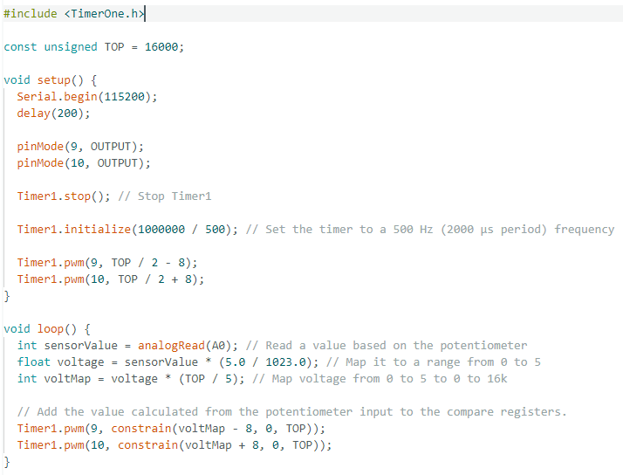
Code Prototyping
This code is an example of what we plan to use to control the gate driver for the bidirectional dc-dc circuit.
We have other code that will be used for the MPPT.

Slide 27
Problems so far
Solutions
Coding the Arduino to accurately control the gate driver, in turn accurately controlling the dc-dc converters
Deriving an efficient method/algorithm for determining the MPPT based on V x I measurements(then implementing the code correctly)
Determining a method for regulating the load voltage and current, as well as ensuring the battery gets the voltage it needs to be charged
Currently Progressing
Currently Progressing
We determined we will need a feedback loop in our Bidirectional DC-DC, we will need to figure out the implementation steps required
Notes:
START OF PRESENTATION STEP 3: PROBLEMS AND TROUBLESHOOTING

Slide 28
Notes:
START OF PRESENTATION STEP 4: SCHEDULING
Tasks:
Task 1: Simulation and Programming ✓
Subtask 1.1: Simulate Buck-boost converter with resistor load ✓
Subtask 1.2: Research MSP-432 functions ✓
Subtask 1.3: Program MSP-432 ✓
Milestone 1.3.1: Complete simulation and programming ✓
Task 2: Hardware prototype
Subtask 2.1: Get a list of parts and place order ✓
Milestone 2.1.1: Complete order placement ✓
Subtask 2.2: Test Gate Driver with function generator ✓
Subtask 2.3: Test Buck-Boost converter with function generator ✓
Subtask 2.4: Test Buck-Boost converter with microcontroller
Subtask 2.5: Test PV-Battery IES prototype
Milestone 2.5.1: complete PV-Battery IES prototype
Task 3: PCB Design, Soldering, and Final Test
Subtask 3.1: Design PCB
Milestone 3.1.1: Submit PCB Design for printing
Subtask 3.2: Soldering
Subtask 3.3: Final Test and Adjustment
Milestone 3.2.1: Complete Final Design
Subtask 3.4: Prepare Final Deliveries
Milestone 3.3.1: Submit all Deliveries

Slide 29
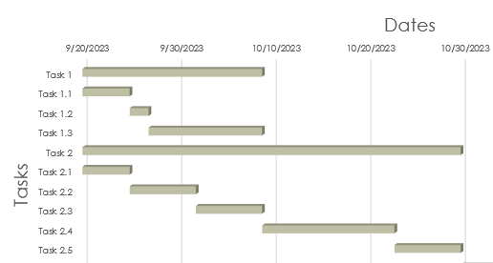
Current vs predicted progress
Originally, we planned to have our circuit ready to test with a battery this week (Task 2.4).
We must backtrack to include some extra simulation and programming to control the pv-array output.
We still plan to have Task 2 complete by the deadline of 10/30/23
Notes:
This slide will be an addition to the current vs predicted progress slide, we will explain how we will need to adjust our schedule to meet our project deadlines.

Slide 31

Thank you for listening

Slide 32

Progress Presentation 2
Sophomore Project
Jose – Challenges and Potential Resolutions
Devin – Schematics and PCB Design
Binh – Introduction and Previous Goals
Jonathan – Future Goals and Progress

Slide 33

Contents
Previous goals
Results and Challenges
Potential Resolutions
PCB schematics
Progress
Future goals
CLOSING and q&A

Slide 34

Previous Goals
Let’s Dive In

Slide 35
Goals
Progress
Coding the Arduino to accurately control the gate driver, in turn accurately controlling the dc-dc converters
Deriving an efficient method/algorithm for determining the MPPT based on V x I measurements (then implementing the code correctly)
Confirm that the Bi-Directional DC-DC converter can seamlessly transition between directions while maintaining the appropriate voltage levels for either charging the battery or the phone
We successfully managed to regulate the buck and boost modes of our DC-DC converter; however, we encountered challenges in achieving the desired voltage intervals
A source code for an MPPT algorithm has been found, we have yet to test for the accuracy of the algorithm
Because there is little room for error, the bi-directional DC-DC testing will be scheduled towards the end of our testing sequence
Previous goals

Slide 36
Results and Challenges

Slide 37
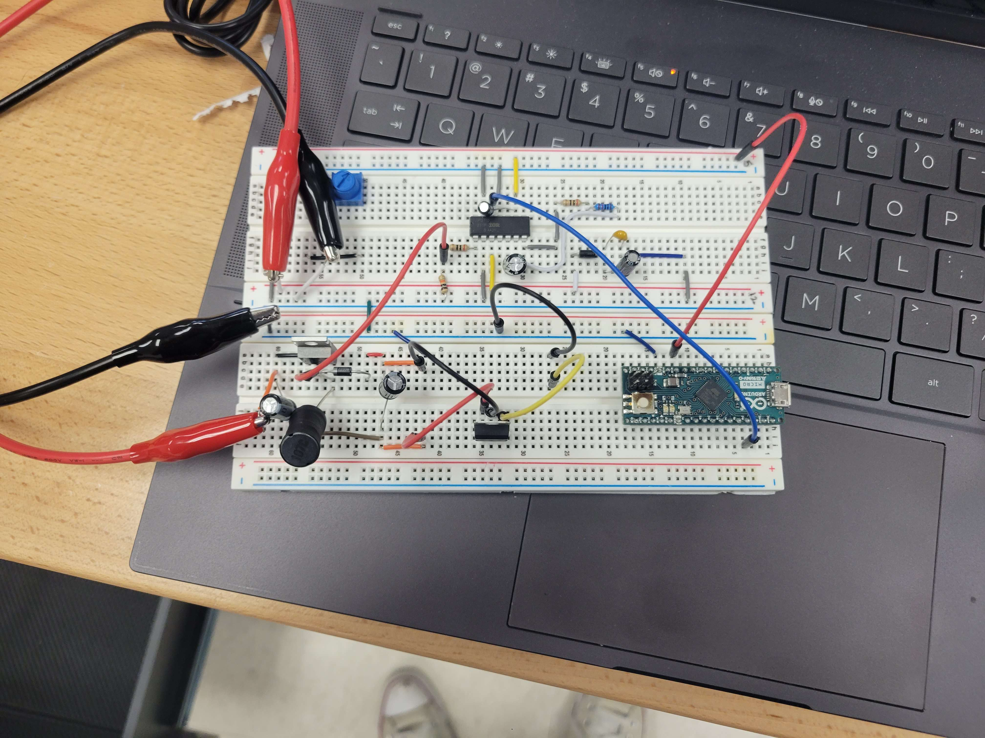
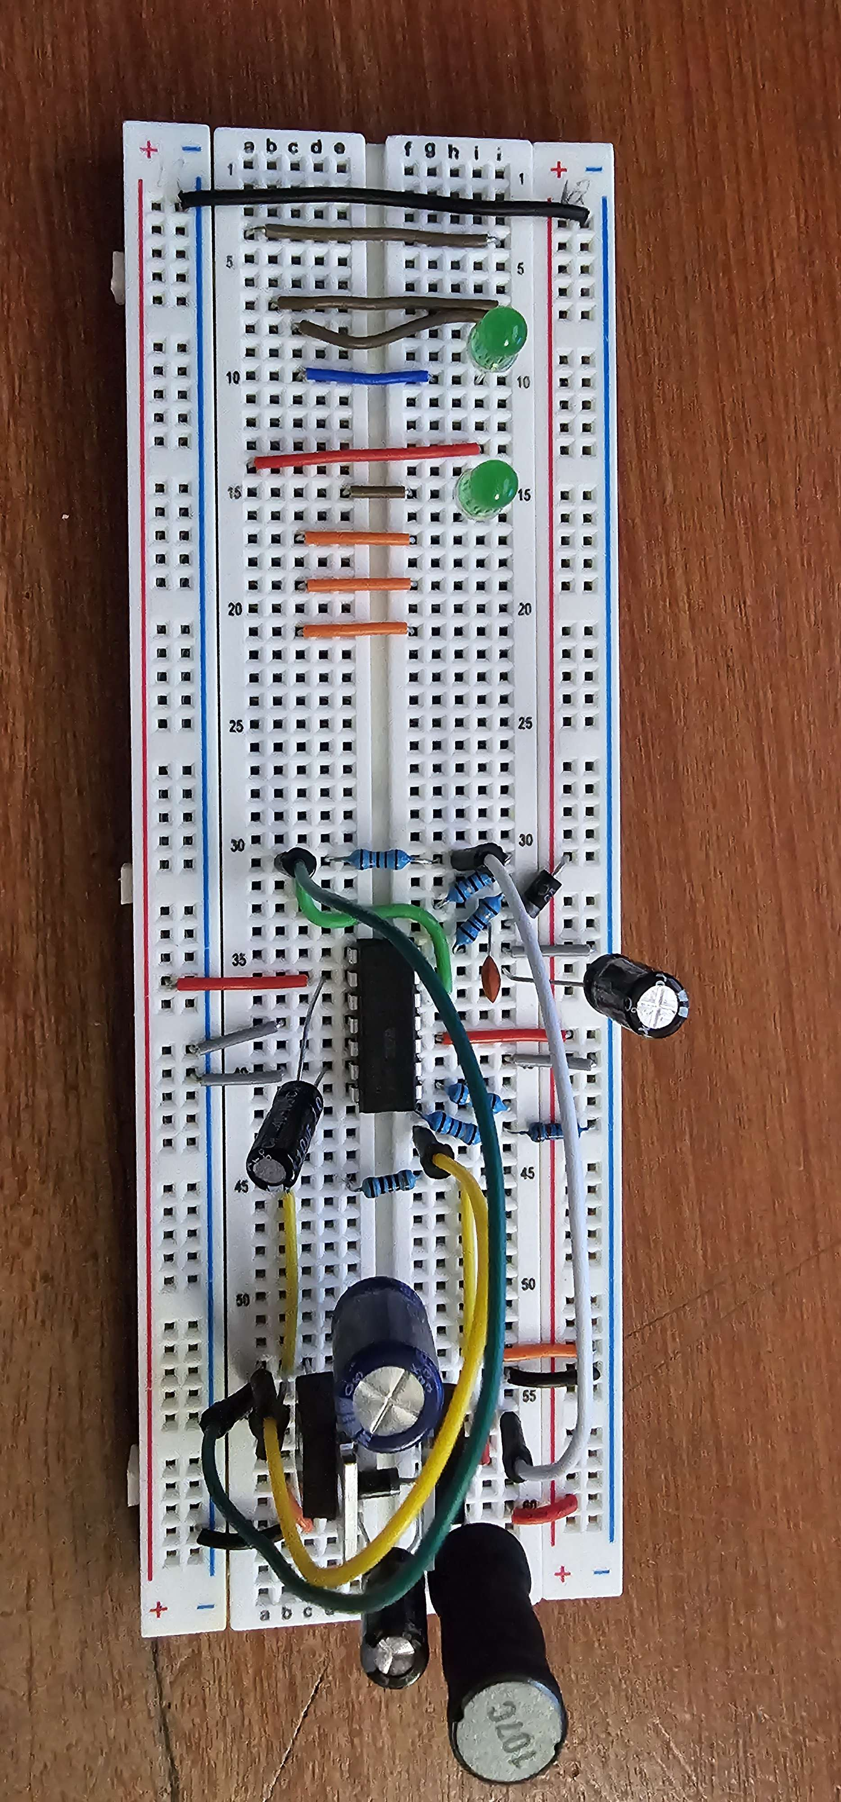
Finished prototype layout for Dc-DC

Slide 38
DC-DC Converter Results
Duty Cycle | Voltage across the load
25% | 4.14
50% | 6.13
75% | 7.13
This table represents our values from the DC-DC converter. In addition, our power supply is set up to input 12V 1A into the circuit; 12V 1A is also sent into the V_{dd} line to fully open and close the MOSFET.
This is our measured voltage across our DC-DC converter as the duty cycle is changed, however the voltage interval seen in the table is incorrect. At 50% duty cycle, the voltage should be similar to 12V. In this case it is half of what it should be; there is an obvious indicator of voltage loss.

Slide 39

Solutions

Slide 40
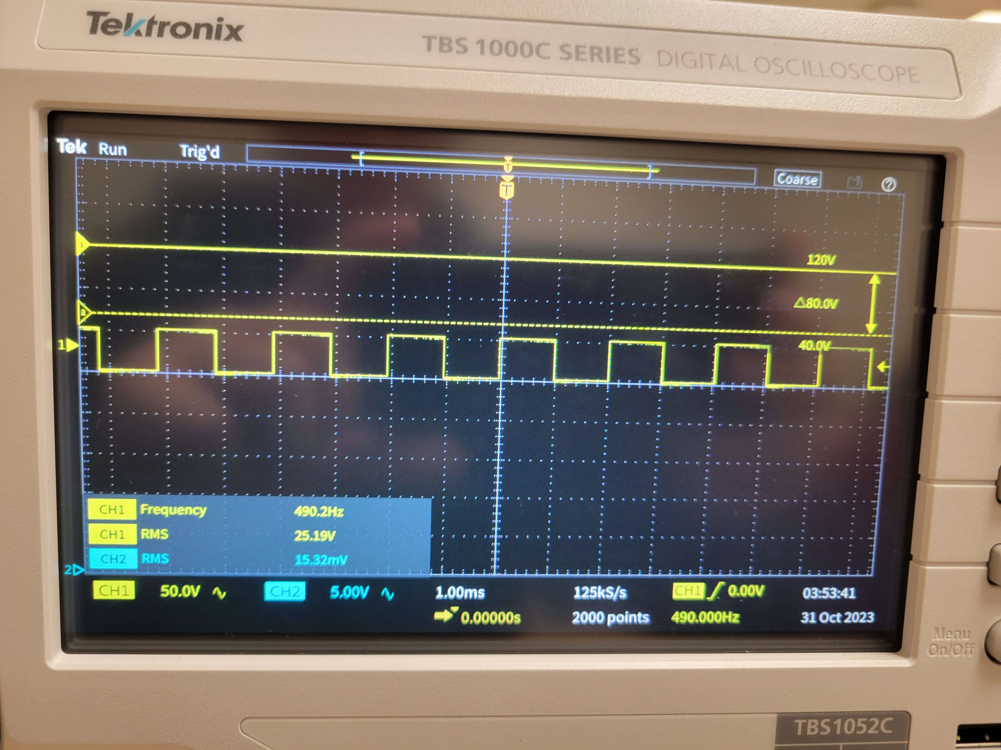
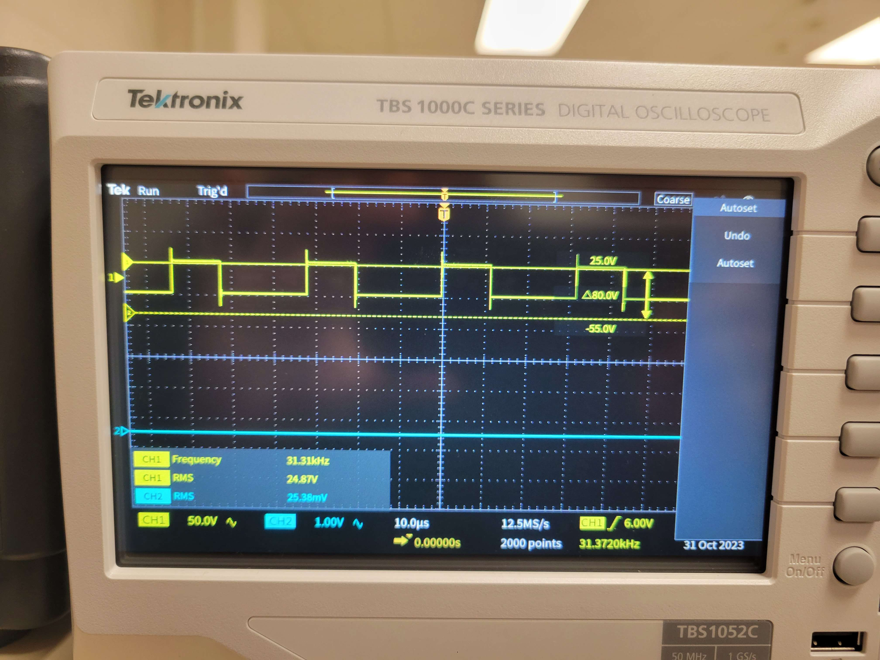
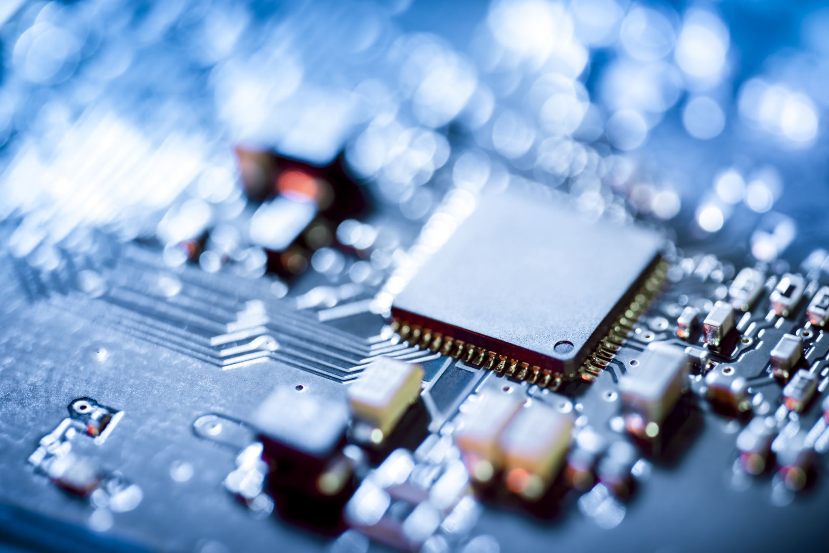
Possible solutions
A potential source of interference in our circuit might stem from an inadequately low frequency of our PWM signal, which was notably below the desired level at 490Hz. To rectify this, our target should be a minimum frequency of 20kHz. Following comprehensive software testing and research, we successfully increased the frequency to 31kHz. Although this enhanced PWM signal is yet to be tested, it holds promise for significantly improving our circuit's performance
A change in component values
Another critical issue potentially impacting our circuit's performance is the use of incorrect component values. By methodically testing the circuit and pinpointing the optimal range of component values, we can significantly guide our circuit towards more efficient functioning

Slide 41
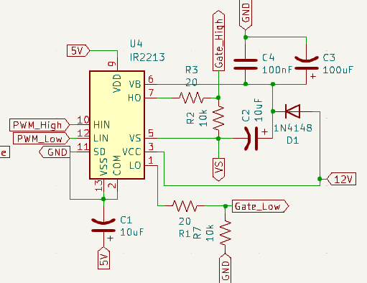
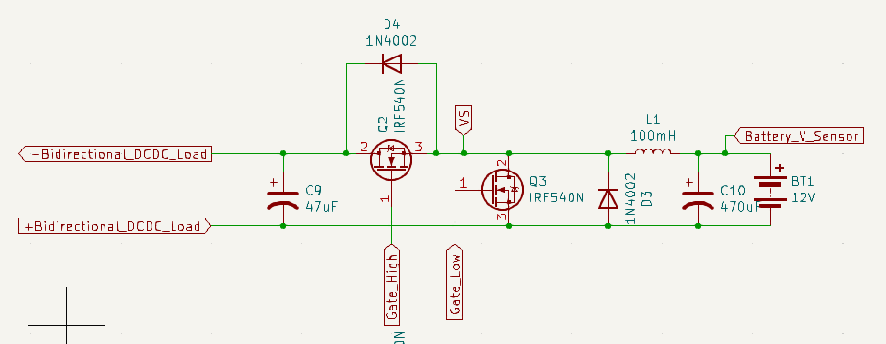
KiCad schematics

Slide 42
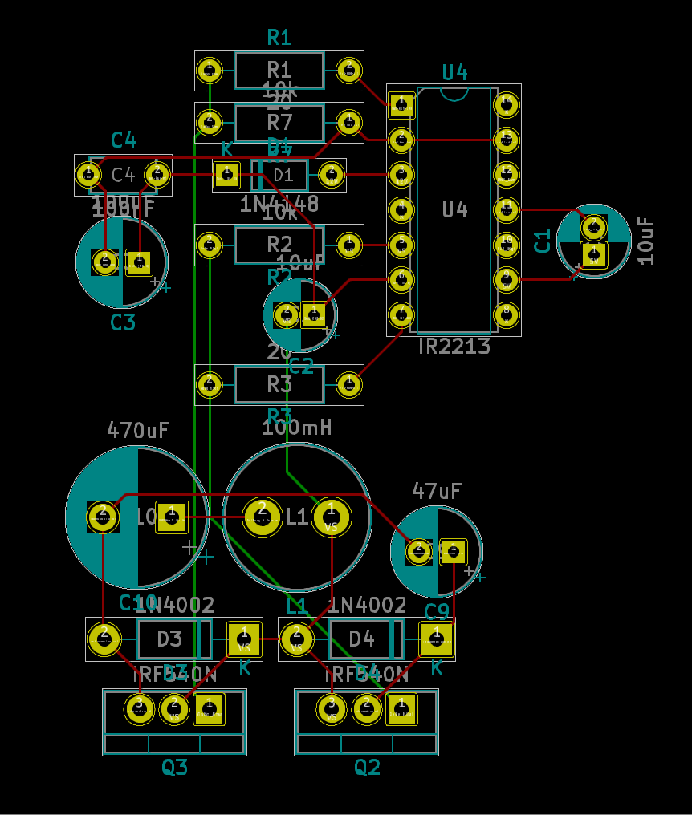
PCB Prototype
Built in KiCad
PCB Schematic for the Bidirectional DC-DC Converter and one of the gate driver circuits.
Built using the circuit schematic made in KiCad beforehand.
The red and green lines represent traces on the PCB.

Slide 43
Where we are...

Slide 44
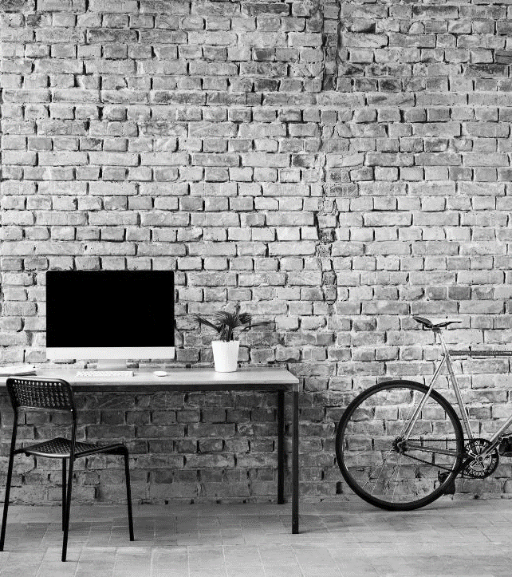
What’s next
LOOKING AHEAD

Slide 45

Goals moving forward
Goals
Test the whole circuit with the solar panel, battery, and a load connected
Finish the PCB design, get it milled, and get components attached
Create an enclosure for the whole board.

Slide 46
Q&A

